Slide 1
Accelerating Higher Education Expansion and Development Operation (AHEAD)
February 09, 2018
MINISTRY OF HIGHER EDUCATION AND HIGHWAYS
WORLD BANK GROUP
UNIVERSITY GRANTS COMMISSION

Slide 2
Key features of AHEAD/Results area 3
Results area 3
Research and Innovation Outcomes
RIC: 3 types of grants and ICE grants
Develop University Business Linkage Cells. Advocate policy reforms.
DOR: 3 types of grants

Slide 3
Results Area three: Promote Research, Development, Innovation & Commercialization
STEM: Sciences, Technology, Engineering, and Mathematics
HEMS: Humanities, Education, Management, Social Sciences

Slide 4
Promote Research, Development, Innovation & Commercialization (RDIC)
AHEAD funds will be invested in improving RDIC through
Sub-Result Area 3.1: Promoting academic research
DORs for the STEM subjects.
DORs for the HEMS subjects.
DORs for a combination of STEM-HEMS research.
Sub-Result Area 3.2: Promoting innovation and commercialization of research
RICs for the STEM subjects.
RICs for the HEMS subjects.
RICs for a combination of STEM-HEMS research.
Innovation commercialization enhancement grants
For the nine programs under the HETC/QIG/W4
Establishment of University business linkage cells
Notes:
This slide will go into the details of results area 3. There are three types of Development-Oriented Research (DOR) programs. Three are also 3 types of Research and Innovation Commercialization (RIC) programs. Innovation commercialization enhancement program s are for the HETC/QIG/W4 winners to improve their commercialization endeavours. In addition, under AHEAD the university-business linkage offices will be developed and strengthened. These UBL cells will function as the Tech Transfer offices and support commercialization of research at universities.

Slide 5
DOR will strengthen STEM and HEMS Development Oriented Research
DOR 2018
STEM:
HEMS:
DOR 2018
STEM + HEMS:
DOR 2019
STEM:
HEMS:
Rs.35 mn, 7 grants
Rs.8 mn, 10 grants
40 mn, 5 grants
35 mn, 7 grants
8 mn, 10 grants
DORs are Competitive grants: Refer to guidelines
Total DOR for STEM = 14
Total DOR for HEMS = 20
Total STEM/HEMS = 05
Grand total = 39

Slide 6
RIC will strengthen STEM and HEMS Research Innovation & Commercialization
RIC 2018
STEM:
HEMS:
RIC 2018
STEM + HEMS:
RIC 2019
STEM:
HEMS:
Rs.45 mn, 7 grants
Rs.10 mn, 4 grants
50 mn, 5 grants
45 mn, 7 grants
10 mn, 4 grants
RICs are Competitive grants: Refer to guidelines
Total RIC for STEM = 14
Total RIC for HEMS = 8
Total STEM/HEMS = 05
Grand total = 27

Slide 7
ICE grants for HETC QIG /W4 winners
Downstream grants from the HETC competition
Awards based on:
Performance under HETC
Subsequent performance
Satisfactory proposals for sustainable future development

Slide 8
Establishment of UBL Cells Based on UGC circular 10/2016
Conducted in 4 phases
Phase | Phase | Maximum score | Required pass mark | AHEAD funds (LKR million)
1 | Establishment of Core UBL Cell | 100 | 70 | -
2 | Completion of the infrastructure for the UBL Cell | 75 | 50 | 4
3 | Operationalization of UBL Cells | 225 | 150 | 2
4 | Outcome of UBL Cells | No limit | 100 | 4
At the completion of Phase 4 a report will be provided to the university with a copy to the OMST. Based on satisfactory progress the UBL cell will be given a further 5 million rupees for the future expansion and development of innovation commercialization activities in the university. Thereafter progress of the UBL cell will be reported annually to the university with a copy to the UGC and OMST.

Slide 9
Results Area Three: Promoting Research, Development, Innovation & Commercialization
AHEAD Program Development Objective (PDO)
PDO 5: Number of competitive RDIC grants for STEM and HEMS disciplines, and interdisciplinary partnerships (STEM and HEMS) awarded and implemented
Disbursement Linked Indicators
DLI 6: University level systems for Research and Development and Innovation and Commercialization (RDIC) programs developed and outcomes achieved
Intermediate outcome indicator 4
The establishment and functioning of UBL Cells at universities in compliance with the circular will be assessed every year.
Notes:
AHEAD outcomes are expected to be achieved at 3 levels. The overall program level is the PDO. What is relevant for results area 3 is PDO 5. This will measure the success of results area 3 as a whole. The degree of success of individual grant winners will be measured through disbursement linked indicators. What is relevant for results area 3 is DLI 6. This will measure a series of milestones in the performance of individual grants. The development of University Business linkage cells will help create a better enabling environment for academics to undertake industry relevant research and development activities. This will be the intermediate outcome indicator number 4 for AHEAD.

Slide 10
Research and Innovation Outcomes
The recipients of DOR and RIC (including ICE) grants must aim to produce “research and innovation outcomes” during the grant period.
Note: The ‘research and innovation outcomes’ are a generic name for research results. Their format will vary across disciplines: for example, communications/presentations at conferences, working papers, journal articles, books, monographs, patents, copyrights, trademarks, license agreements.
Notes:
communications/presentations at conferences, working papers, journal articles, books, monographs, patents, copyrights, trademarks etc are considered as research and innovation outcomes and all competitive grant winners must aim to achieve a certain number of such outcomes during the grant period. The objectives is to build a culture of research and innovation in the relevant dept/faculty or study program which will be continued beyond the life of AHEAD

Slide 11
Expected DOR outcomes
2018
Commencement of the DOR
2018
Research communication or a working paper or equivalent
2019
Journal article/book/monograph etc.
Second round DORs winners will start in 2019 and will complete in 2021

Slide 12
DOR: Key Performance Indicators
No. | Key Performance Indicators | Baseline | Year 1 | Year 2 | Year 3 | Final | Evidence*
1 | Number of working papers | 0
2 | Number of communications (abstract) | 0
3 | Number of papers presented at national conferences/symposia | 0
4 | Number of papers presented at international conferences/symposia | 0
5 | Number of research publications in peer reviewed national journals | 0
6 | Number of research publications in peer reviewed internationally indexed journals | 0
7 | Number of research publications as books or monographs published by reputed national publishers | 0
8 | Number of research publications as books or monographs published by reputed international publishers | 0
Baseline, end of year 1-3 are not cumulative. The final KPI is cumulative
* Evidence need not be filled at the proposal writing stage

Slide 13
Expected RIC/ICE outcomes
2018
Commencement of the RIC
2018
Formal agreement with the commercial partner
2019
Submission for intellectual property protection and/or commercialization
Second round RIC winners will start in 2019 and will complete in 2021

Slide 14
Types of Intellectual Property (IP)
Property that results from intellectual creations
IP
Copyright and related rights
Protection of new varieties of plants
Industrial designs
Patents
Trade marks

Slide 15
RIC/ICE: Key Performance Indicators
No. | Indicator | Baseline | Year 1 | Year 2 | Year 3 | Final | Evidence*
1 | Number of national patents | 0
2 | Number of international patents | 0
3 | Number of industrial designs | 0
4 | Number of national copyrights (e.g. software) | 0
5 | Number of international copyrights (e.g. software) | 0
6 | Number of national trademarks | 0
7 | Number of international trademarks | 0
8 | Number of Patent Cooperation Treaties (PCTs) | 0
9 | Number of license agreements | 0
10 | Number of assignments of IP | 0
11 | Number of commercialized products | 0
12 | Number of industry-university linkages (MOU or agreements) for research commercialization | 0
Baseline, end of year 1-3 are not cumulative. The final KPI is cumulative
* Evidence need not be filled at the proposal writing stage

Slide 16
Innovation awards from Sri Lanka Inventors Commission (SLIC)
Sahasak Nimavum: National Exhibition for Inventions & Innovations
University and Tertiary Education Institutes category
The competition under 14 technical fields
F – 01 - Public Safety, Welfare and National Defense
F – 02 - Physics
F – 03 - Medicine and Pharmacy
F – 04 - Traditional Medicine
F – 05 - Agriculture
F – 06 - Food Technology
F – 07 - Chemistry
F – 08 - Applied Sciences and Technology
F – 09 - Energy
F – 10 - Environmental Conservation
F – 11 - Engineering
F – 12 - Information and Communication Technology
F – 13 - Transportation
F – 14 - Public Works and Infrastructure Engineering

Slide 17
Potential outcomes from UBL cells
At least
Five hundred thousand rupees royalty revenue per year
Sale of technology transfer or IP worth a minimum of one million
One technology developed to enhance the business of firms in Sri Lanka (or overseas)
One policy developed based on research conducted by STEM and/or HEMS
One industry process/logistics improved by research conducted by HEMS
One local company investing to commercialize a technology developed by STEM/HEMS
One foreign direct investment to commercialize a technology developed by STEM/HEMS
One Business Process Out sourcing solution developed via research
One e-commerce solution
One PCT (Patent Corporation Treaty) submitted by STEM
One international trademark developed by HEMS
One start up company based on a technology developed by STEM/HEMS
Creation of employment opportunities (two) by a start-up company

Slide 18
Can the researchers at Sri Lankan Universities contribute towards private sector driven economic growth?
Value added exports
Foreign direct investment for commercialization
Value added and more profitable services
Disruptive innovation
Commercial exploitation of IP

Slide 19
Technical Support from other Organizations towards research and innovation
AHEAD design is complementary!

Slide 20
World Intellectual Property Organization (WIPO)/EIE
Creating an enabling intellectual property environment to increase the capacity and pace for technology scouting, absorption, adaptation & innovation in developing and least developed countries

Slide 21
WIPO/EIE
Initially, the Project assembles a suite of complementary and related capacity-building and technical assistance activities from various Sectors of WIPO to form a prospectus to accomplish the long-term goal of building capacity and pace for technology scouting, absorption, adaptation and innovation using IP tools for developing countries and least developed countries. Various programs and initiatives, such as the Technology and Innovation Support Center (TISC), the Distance Learning (DL) Courses, University Technology Licensing and Patent Drafting Training, among others, are linked into a logical curriculum.

Slide 22
Commercial Law Development Program (CLDP) U.S. Department of Commerce
University IP policy project workshop was held during April 24-27, 2017
Sri Lanka-US cooperation: University IP policy working group held on September 11-12, 2017 Sponsored by CLDP. This was done in coordination with
University Grants Commission (UGC)
National Intellectual Property Organization (NIPO)
United States Patent and Trademark Office (USPTO)
World Intellectual Property Organization
U.S. Embassy Colombo

Slide 23
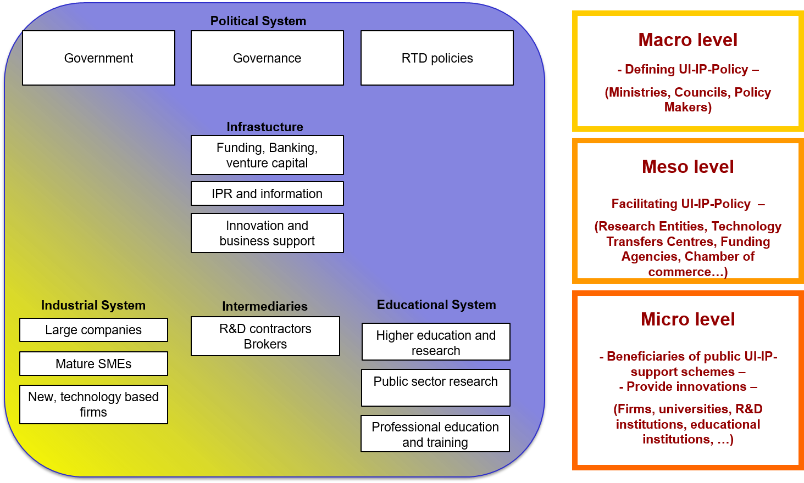
Policy for University-Institute-Industry Partnerships (UI-IP)
Coordinated by National Science Foundation, Ministry of Science, Technology and Research
Technical support from GIZ
Follow a detailed three level logic of the UI-IP policy

Slide 24
National Intellectual Property Policy formulation
Coordinated by Ministry of Industry and Commerce
Funded by WIPO/EIE

Slide 25
Results Area 3: US$ 16 million (~Rs. 2400 million) Promoting Research, Development, Innovation and commercialization (RDIC)
University Business Linkage Offices (UBL)
Total allocation LKR 225 million: No of grants (15)
Research Innovation and Commercialization (RIC)
Total allocation LKR 960 million: No. of grants (27)
Innovation Commercialization Enhancement (ICE)
Total allocation LKR 315 million: No. of grants (9)
Development oriented Research (DOR)
Total allocation LKR 850 million: No. of grants (39)
Notes:
This slide presents the overall framework of AHEAD results area 3. The outer blue circle represents the DOR grants. The inner purple circle represents the RIC and ICE grants. The inner core in green represents the UBL cells. These UBL cells will support the Universities for their research commercialization activities.

Slide 26
Improve the university ranking
Results area three has higher weightage to improve the University ranking such as THE
Notes:
Finally the results area 3 will have a direct impact on the University ranking. As an example Times Higher Education Ranking allocated 30% for research (Reputation survey:18%, Research income: 6%, Research productivity: 6%), 30% for citations and 2.5% for industry income. Some percentage of international outlook is also arising from research. Hence one can say RDIC has about 65 % contribution towards improvement in ranking

Slide 27
Thank You!
DOR, RIC, ICE guidelines and UBL cell score card will be emailed today.

